Slide 1
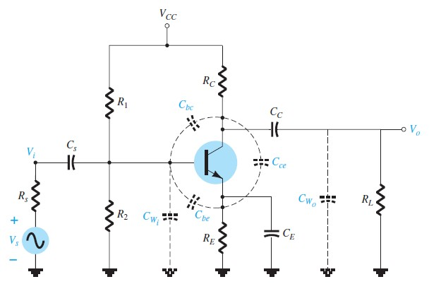
University of Diyala Engineering College
Department of Communications Engineering
Electronics II : 3^{ed} Year - 2015/2016 By: Hussein Ahmed Mahmood
HIGH-FREQUENCY RESPONSE-BJT AMPLIFIER
In Fig. 11, the various parasitic capacitances (C_{be} , C_{bc} , C_{ce}) of the transistor are included with the wiring capacitances (C_{Wi} , C_{Wo}) introduced during construction. The high-frequency equivalent model for the network of Fig. 11 appears in Fig. 12. Note the absence of the capacitors C_{S}, C_{C}, and C_{E}, which are all assumed to be in the short-circuit state at these frequencies.
Fig.11
Network of Fig.11 with the capacitors that affect the high-frequency response.
Fig.12
High-frequency ac equivalent model for the network of Fig. 11

Slide 2
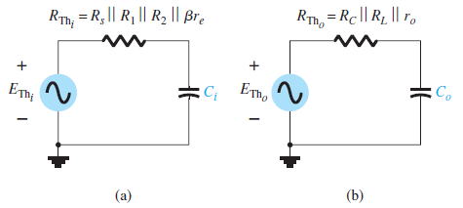
University of Diyala Engineering College
Department of Communications Engineering
Electronics II : 3^{ed} Year - 2015/2016 By: Hussein Ahmed Mahmood
Determining the Thevenin equivalent circuit for the input and output networks of Fig.12 results in the configurations of Fig.13 For the input network, the - 3dB frequency is defined by:
With
And
Fig.13
Thevenin circuits for the input and output networks of the network of Fig.12
For the output network
With

Slide 3
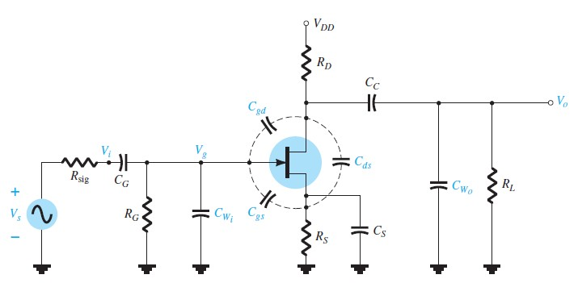
University of Diyala Engineering College
Department of Communications Engineering
Electronics II : 3^{ed} Year - 2015/2016 By: Hussein Ahmed Mahmood
And
or
For Ay large (typical): And
HIGH-FREQUENCY RESPONSE-FET AMPLIFIER
The analysis of the high-frequency response of the FET amplifier will proceed in a very similar manner to that encountered for the BJT amplifier. As shown in Fig.14, there are interelectrode and wiring capacitances that will determine the high-frequency characteristics of the amplifier.
Fig.14
Capacitive elements that affect the high-frequency response

Slide 4
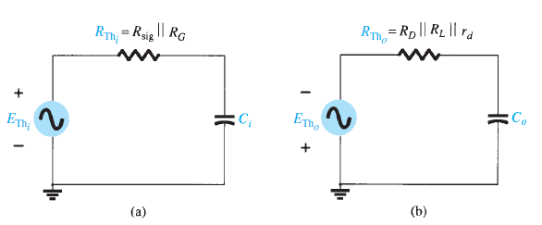
University of Diyala Engineering College
Department of Communications Engineering
Electronics II : 3^{ed} Year - 2015/2016 By: Hussein Ahmed Mahmood
Fig.15
High-frequency ac equivalent circuit for Fig.14.
Fig.16
The Thevenin equivalent circuits for: (a) the input circuit and (b) the output circuit.
The cutoff frequencies defined by the input and output circuits can be obtained by first finding the Thevenin equivalent circuits for each section as shown in Fig.16. For the input circuit.
And
10

Slide 5
University of Diyala Engineering College
Department of Communications Engineering
Electronics II : 3^{ed} Year - 2015/2016 By: Hussein Ahmed Mahmood
With
And
For the output circuit,
With
And And
11

